Slide 1
Name Generator (presentation-2)

Slide 2
Project Introduction

Slide 3
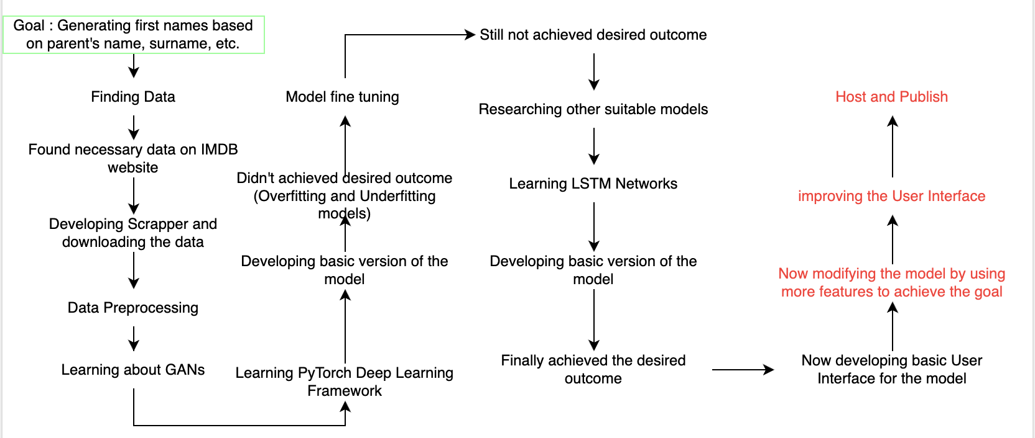
Project Journey overview

Slide 4
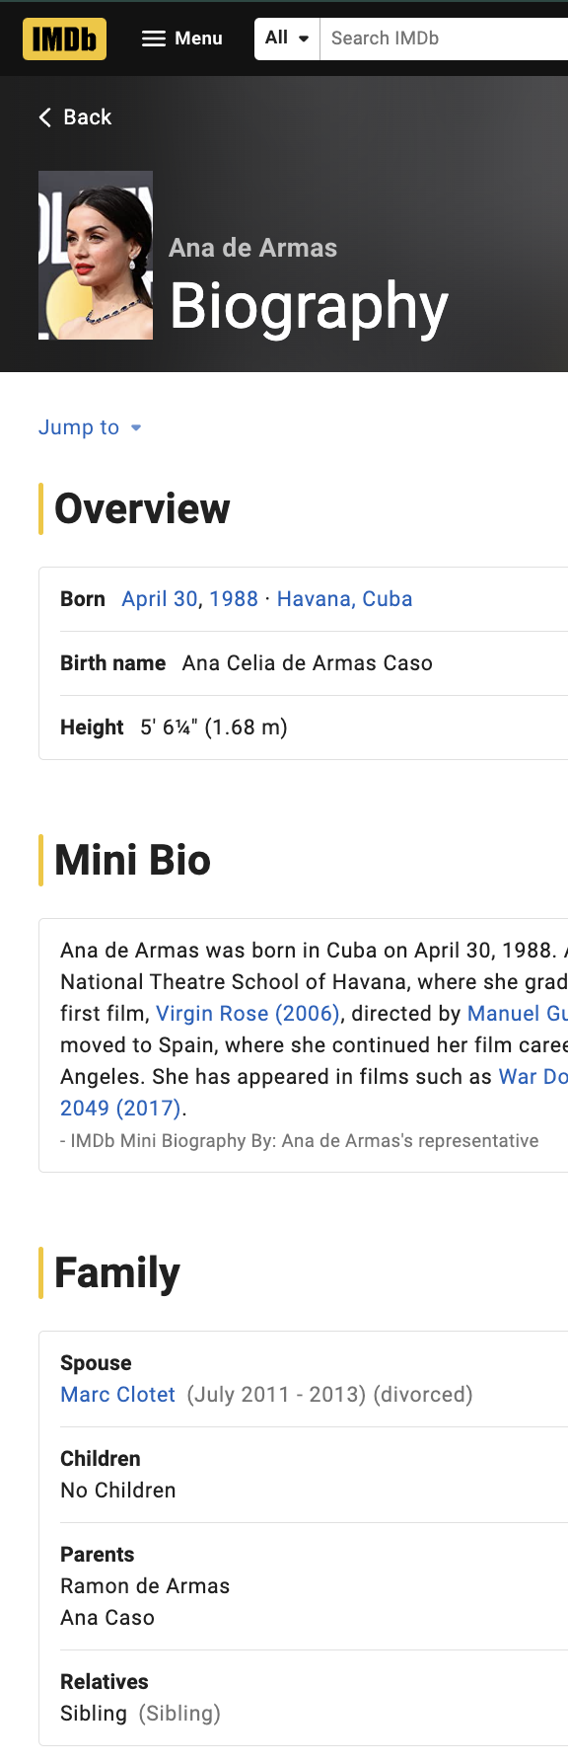

Data Gathering

Slide 5
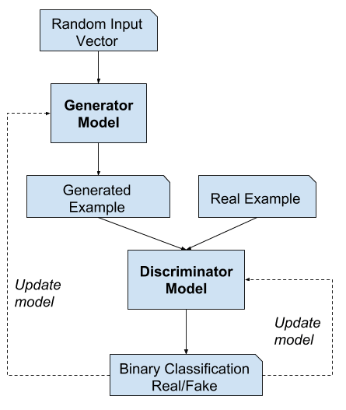
Generative Adversarial Networks

Slide 6
How I used GAN for this Project
For Basic Model Only used first names for input
Encoded name text data to it’s ordinal values
Used fixed length for input tensor by padding with “ “.
Scaled the input tensor to be in range [0, 1]
Created Real/Fake Classifier Discriminator with Sigmoid at the end
Created Generator with TanH at the end so that final output tensor will be in same range as input tensor, [0, 1]
Inverse Transformed Scaled output tensor
Converted output tensor back to characters from ordinal values
Used Cross Entropy as loss function and Adam as optimizer
Trained over different Epochs and Learning Rates
Skip to the good part >>

Slide 7
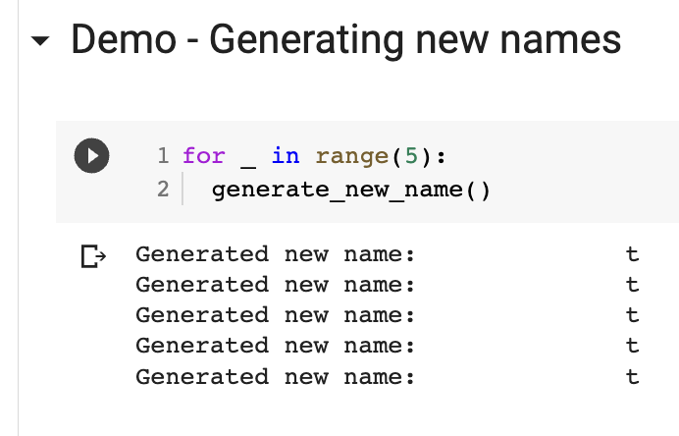
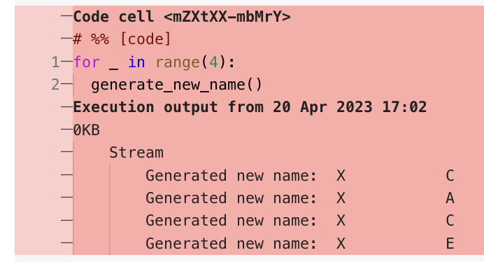
Fine Tuning the GAN based Model
High Epoch or more hidden layers => Over Fit
Low Epoch or less hidden layers => Under Fit
Generates same thing all the time
Generates gibberish names
Like “jfskdlak”

Slide 8
Why GANs did NOT worked for this project
“the Generative Adversarial Networks, were designed to cope with continuous information (image) instead of discrete data (text).”^{[1]}
[1] https://www.sciencedirect.com/science/article/abs/pii/S0031320321002855

Slide 9
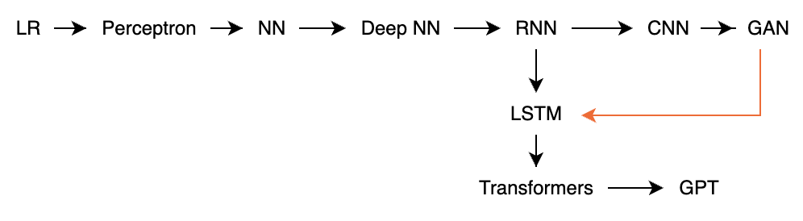
Moved to LSTM Networks
GANs (Generative Adversarial Networks) are a type of deep learning model that are typically used for generating images, videos, and other types of visual media. While it's possible to use GANs for generating text, it's generally more difficult and less common than using other models like LSTMs.
LSTMs (Long Short-Term Memory Networks) are a type of recurrent neural network that are well-suited for processing sequential data, like text. They have been widely used for tasks like language modeling, machine translation, and text generation.

Slide 10
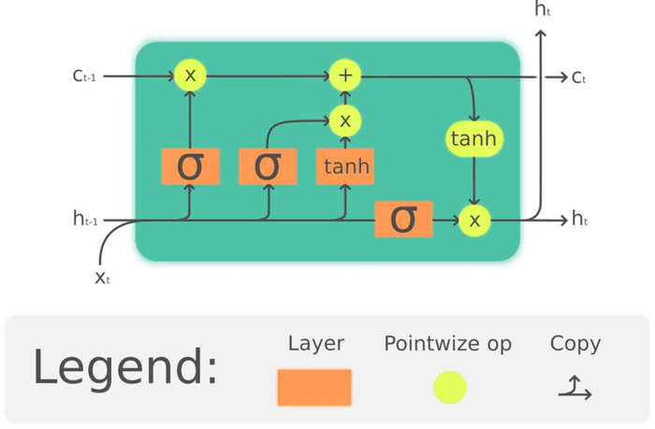
LSTM Networks
remove gate
add gate
Predicts next character of a name based on current character value
J e _ _
(27) (27) ← alphabets + “.”
e l ← most probable characters according to
LSTM Model
Recurrent Part
Easy to use thanks to PyTorch Framework

Slide 11
How I used LSTM Networks
Only used First names for basic model
Preprocessed names using custom lowercase ascii id
Created train data loader based on name occurrence proportion
Created Model with LSTM, FC, ReLU, FC Architecture
Generating name using given starting characters
Randomly selecting a character from top k predicted characters
Repeating that till generated character is not “.” or length is not max
Used Cross Entropy as Loss Function, Adam as optimizer
Fine tuned using LR Scheduler
Trained the model over different epochs and learning rates

Slide 12
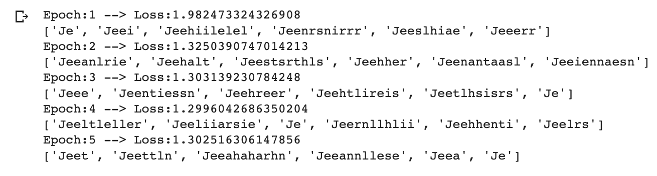
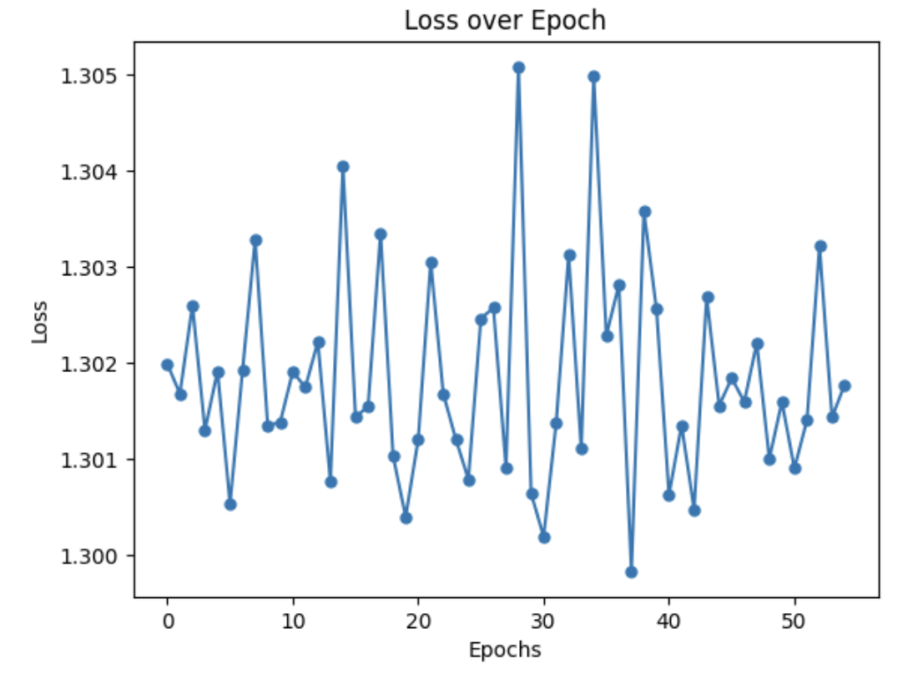
Training Results

Slide 13
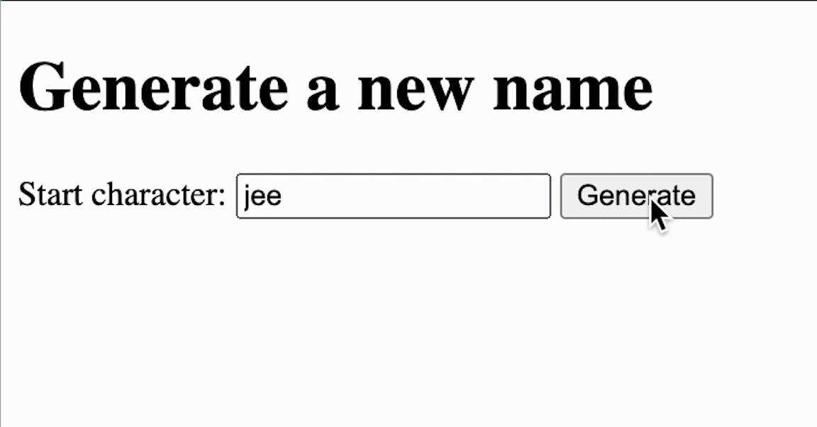
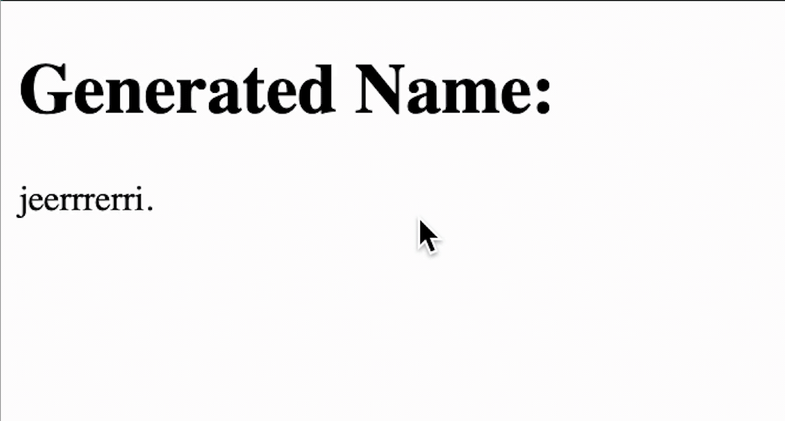
Website Interface

Slide 14
Thank You
Go back to the Journey >>

